Slide 1
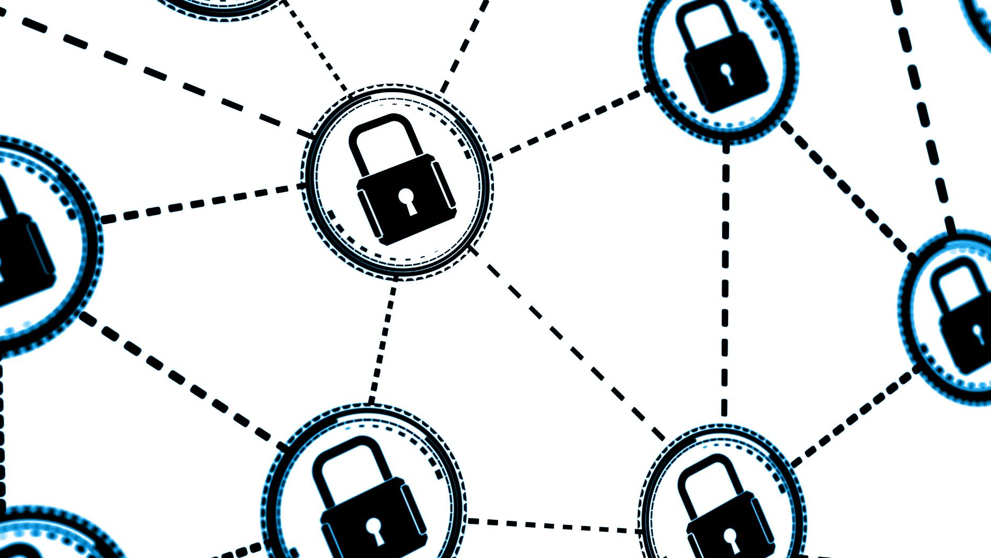
Transactional analysis
Understanding findings in sample file.
Notes:
“Good morning/afternoon. Thank you for the opportunity to present my findings on the sample transactional data.”
“Today, I will walk you through key insights, recommend additional data to improve detection, and propose prevention strategies.”
“Let’s begin with an overview of our discussion topics.”

Slide 2
Discussion Topics
Data Analysis & Key Findings
Additional Data to Enhance Fraud Detection
Fraud & Chargeback Prevention Recommendations
Notes:
“Our presentation is organized into three main sections:”
Data Analysis & Key Findings – what suspicious behaviors we uncovered.
Additional Data to Enhance Fraud Detection – which new signals to integrate.
Fraud & Chargeback Prevention Recommendations – how to act on these insights.
“We will conclude with next steps and open the floor for questions.”

Slide 3
Data Analysis & Key Findings
Notes:
“In this section, we dive into the transactional dataset of 3 199 records with a 12.2 % chargeback rate.”
“I’ll highlight three patterns: high‑risk users/devices, test‑and‑hit behaviors, and temporal clustering.”

Slide 4
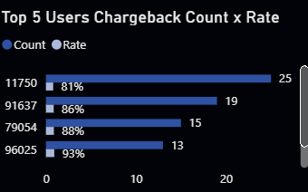
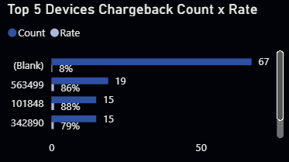
High-risk users & devices
The top 5 users account for disproportionately high chargeback rates (81%–93%), despite being a small fraction of total transactions.
Similarly, a handful of devices show both elevated chargeback counts and rates (up to 93%).
Notes:
“First, a small group of five users accounts for over 80 % chargeback rate, despite minimal transaction volume.”
“Similarly, certain devices show chargeback rates up to 93 %.”
“Such concentration suggests either credential misuse or “friendly fraud” by repeat offenders.”
Action: “I recommend placing these user_ids and device_ids into a manual‑review queue with heightened authentication.”

Slide 5
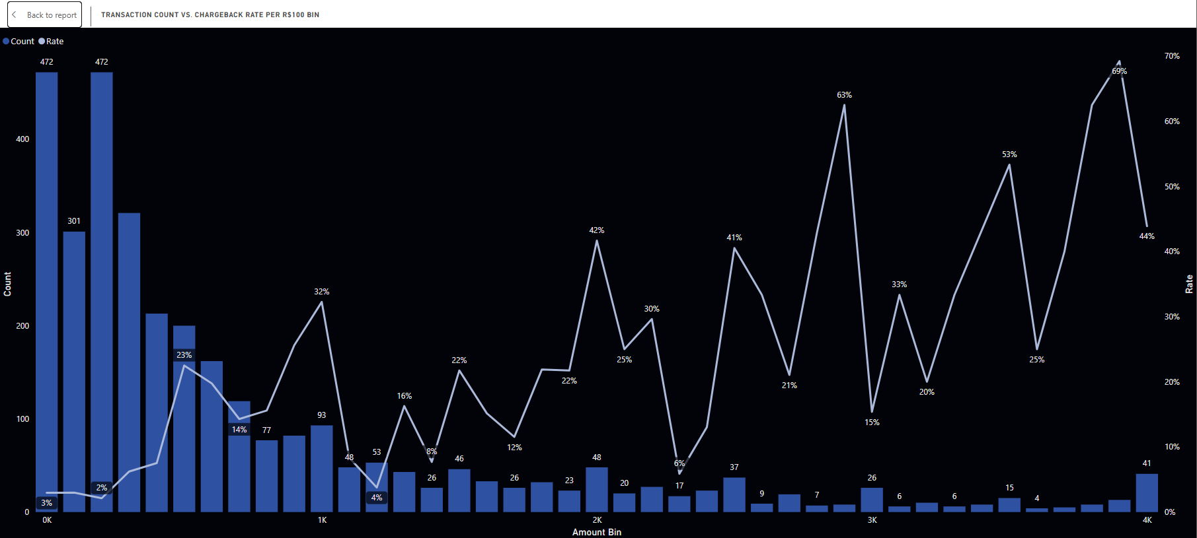
Amount Based “Test and Hit” Patterns
Chargeback frequency peaks in low‑value bins (R$0–100 and R$100–200), then drops sharply, then briefly resurges at mid/high values, consistent with “test small amount → validate stolen card → commit larger fraud”.
Notes:
“Next, we see chargebacks spike in the R$ 0–100 and R$ 100–200 bins, then dip, then re‑emerge at higher values.”
“This “test small amount → validate stolen card → larger fraud” cycle is a classic CNP fraud tactic.”
Action: “Implement dynamic amount‑based velocity rules to decline or challenge sequential small‑value attempts followed by larger purchases.”

Slide 6
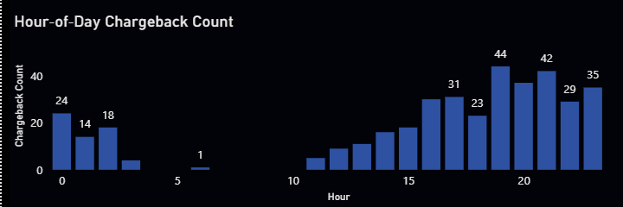
Temporal clustering
Chargebacks cluster in off‑peak hours, showing automated or scripted fraud tries when human review may be slowest.
Notes:
“Our heatmap analysis reveals chargebacks cluster in off‑peak hours—particularly midnight to 4 a.m.—when manual review is slowest.”
“This timing indicates automated or scripted fraud attempts.”
Action: “Tighten real‑time monitoring and lower risk thresholds during these high‑risk windows (e.g., require 3D Secure).”

Slide 7
Additional Data to Enhance Fraud Detection
Notes:
“Beyond transactional logs, integrating external signals can improve detection accuracy.”
“We will consider four categories of data in the next slide.”

Slide 8
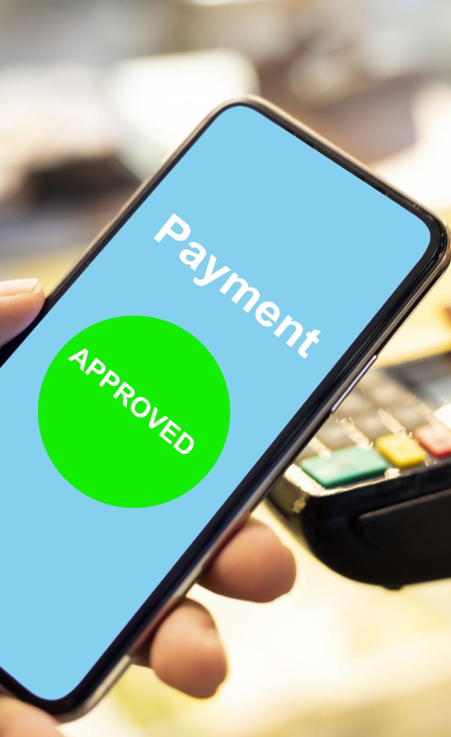
Future integrations
Device & Network Metadata
IP geolocation, VPN/proxy flags, browser fingerprint scores, and device fingerprinting.
Customer Profile & Historical Trends
Lifetime chargeback history, average order value per user, and account age.
Order Fulfillment Data
Shipping address velocity (same address used by multiple cards), carrier GPS stamps, and proof of delivery images.
External Fraud Feeds
BIN risk scores, global fraud deny lists, and peer network alerts from other merchants.
Notes:
Device & Network Metadata: “IP geolocation, VPN/proxy flags, and browser fingerprint scores help identify anomalous access.”
Customer Profile & Historical Trends: “Lifetime chargeback history and average basket size reveal account‑level risk.”
Order Fulfillment Data: “Shipping address velocity and proof‑of‑delivery images validate legitimate orders.”
External Fraud Feeds: “BIN risk scores and peer‑merchant deny lists provide community‑wide intelligence.”
“Integrating these feeds will enrich our rule engine and reduce false positives.”

Slide 9
Fraud & Chargeback Prevention Recommendations
Notes:
“Based on our findings, I propose a layered prevention framework combining rules, authentication, and operational processes.”
“The next slide details actionable steps.”

Slide 10

Fraud Prevention recommendations
Hybrid Rule-and-ML Engine
Enforce velocity/amount rules and time window restrictions.
Step-Up Authentication
Trigger 3D Secure or OTP verification for medium risk transactions (e.g., new device, high value purchase, or off hour order).
Manual Review & Rapid Response
Automatically route transactions above a specified risk threshold to a specialized team for the same day review.
Continuous Monitoring & Feedback Loop
Collect outcome data from disputes and chargeback representments to retrain the ML model and tune rule parameters, ensuring the system adapts to emerging fraud tactics.
Notes:
Hybrid Rule‑and‑ML Engine
“Start with deterministic rules (velocity, amount bins) and plan for ML augmentation later.”
Step‑Up Authentication
“Trigger 3D Secure or OTP for medium‑risk transactions (e.g., new device, high value, off‑hours).”
Manual Review & Rapid Response
“Automatically route flagged transactions to a dedicated team for same‑day investigation.”
Continuous Monitoring & Feedback Loop
“Ingest dispute outcomes to refine rule thresholds and train future models, ensuring the system adapts to new fraud patterns.”
“This multi‑tiered approach balances risk mitigation with customer experience.”

